Slide 1


Jia Shen Ang
18 July 2022

Slide 2

Outline
Executive Summary
Introduction
Methodology
Results
Conclusion
Appendix

Slide 3
Executive Summary
Summary of methodologies – The following methodologies were used to analyze data:
Data Collection using web scraping and the SpaceX API
Exploratory Data Analysis (EDA) – data wrangling, data visualization
Machine learning predictions
Summary of all results
Data was successfully collected using web scrapping and API
EDA allowed us to identify key features of successful landings.
Machine Learning Prediction showed the best model to use when making predictions on the collected data.

Slide 4
Introduction
This project is to evaluate the viability of our new company SpaceY and its ability to compete with SpaceX
Problems we want to find answers to:
To find the best way to estimate the total cost of launches by predicting successfully landing of rocket first stages
Identify ideal locations for where we can launch rockets.

Slide 5

Section 1

Slide 6
Methodology
Executive Summary
Data collection methodology:
SpaceX data was acquired from two sources, the first from Wikipedia. The second from the SpaceX API
Perform data wrangling
Collected data was processed to create labels based on the landing outcome
Perform exploratory data analysis (EDA) using visualization and SQL
Perform interactive visual analytics using Folium and Plotly Dash
Perform predictive analysis using classification models
How to build, tune, evaluate classification models

Slide 7
Data Collection – SpaceX API
Data was collected by sending a get request to the SpaceX API
The API responded to the get request in a JSON format
The data was parsed into a Pandas Data Frame
The data frame was then cleaned up
Filtering only Falcon 9 rockets
Dealing with missing values
Data then exported to CSV
Github URL:
https://github.com/jiashenang/IBM-AppliedDataScienceCapstone/blob/master/1-1%20-%20Data%20Collection%20API.ipynb
Python
https://api.spacexdata.com/
Get request
Parse and clean up response
Response

Slide 8
Data Collection - Scraping
Data was scraped from tables on Wikipedia
Scraping was made possible with the following libraries
Request
Beautiful soup
Pandas
Github URL: https://github.com/jiashenang/IBM-AppliedDataScienceCapstone/blob/master/1-2%20-%20Data%20Collection%20with%20Web%20Scraping.ipynb
HTTP Get Request to Wikipedia
Parse response with Beautiful Soup
Identify tables with required data
Export Results to CSV
Convert data into Pandas Data Frame
Extract data from relevant table

Slide 9
Data Wrangling
Initial Exploratory Data Analysis was done to see:
Number of launch sites
Number of each orbit type
Outcomes of landing attempts
Finally, labels were created for each landing outcome
1 for a successful landing attempt
0 for an unsuccessfully landing attempt
Github URL: https://github.com/jiashenang/IBM-AppliedDataScienceCapstone/blob/master/1-3%20-%20Data%20Wrangling.ipynb
EDA
Label Creation

Slide 10
EDA with Data Visualization
In general Scatter Charts were plotted to see the relationship between pairs of features
A bar chart was plotted to visualize success of each type of orbit
And a line chart was used to visualize the overall success rate over time.
Github URL: https://github.com/jiashenang/IBM-AppliedDataScienceCapstone/blob/master/2-2%20-%20EDA%20with%20Visualization.ipynb

Slide 11
EDA with SQL
Query the name of the unique launch sites
Query 5 records where the launch site’s name begins with the string ‘CCA’
Query the total payload mass carried by boosters launched by NASA (CRS)
Query the average payload mass carried by booster version F9 v1.1
List the date when the first successful landing outcome in ground pad was achieved
List the names of the boosters which have success in drone ship and have payload mass greater than 4000 but less than 6000
List the total number of successful and failure mission outcomes
List the names of the booster_versions which have carried the maximum payload mass. Use a subquery
List the failed landing_outcomes in drone ship, their booster versions, and launch site names for in year 2015
Rank the count of landing outcomes (such as Failure (drone ship) or Success (ground pad)) between the date 2010-06-04 and 2017-03-20, in descending order
Github URL: https://github.com/jiashenang/IBM-AppliedDataScienceCapstone/blob/master/2-1%20-%20EDA%20with%20SQL.ipynb

Slide 12
Build an Interactive Map with Folium
Markers, circles, lines and map cluster were use to a folium map
Marker were used to mark key launch sites
Circles were used to highlight specific coordinates
Lines were used to show distance between two points
Clusters were used to group together events – in this case launch attempts
Github URL: https://github.com/jiashenang/IBM-AppliedDataScienceCapstone/blob/master/3-1%20-%20Interactive%20Visual%20Analytics%20with%20Folium.ipynb

Slide 13
Build a Dashboard with Plotly Dash
The following plots and charts were plotted
A pie of successful launch by site, or from the site depending on the value selected
A scatter to plot payload mass and successful landing, payload mass can be selected using a slider
Add the GitHub URL of your completed Plotly Dash lab, as an external reference and peer-review purpose
Github URL: https://github.com/jiashenang/IBM-AppliedDataScienceCapstone/tree/master/3-2%20-%20Dash

Slide 14
Predictive Analysis (Classification)
4 Models were built using: Logistic Regression, SVM, Classification Trees and K Nearest Neighbors
The models were then compared
Github URL: https://github.com/jiashenang/IBM-AppliedDataScienceCapstone/blob/master/4-1%20-%20Machine%20Learning%20Prediction.ipynb
Data preparation and standardization
Test each model with combination of hyper parameters
Compare Results

Slide 15
Results
Exploratory data analysis results
SpaceX uses 4 launch sites
SpaceX has been able to successfully launch payloads into orbit very reliably around 100% of the time on some orbits. They are also now able to land about 80% of their first stage boosters giving them enormous cost savings in reuse.
Interactive analytics demo in screenshots
Predictive analysis results
Predictive analysis did not yield any models which stood out from the rest they preformed equally when using the test data.

Slide 16

Section 2

Slide 17
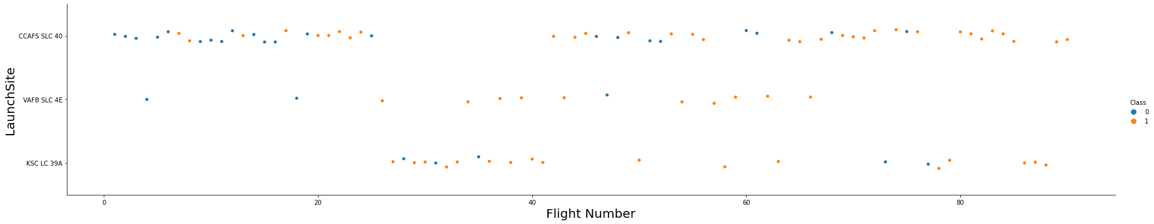
Flight Number vs. Launch Site
Earlier launches took place from CCAFS SLC, and many of those ended in failure to land.
At around 20 flights, the success rate of missions went up dramatically
Of the three sites, VAFB SLC which is on the west coast is used the least.
Large gap in launches around flight 29 from CCAFS SLC caused by a launch pad explosion of a Falcon 9 rocket during testing.

Slide 18
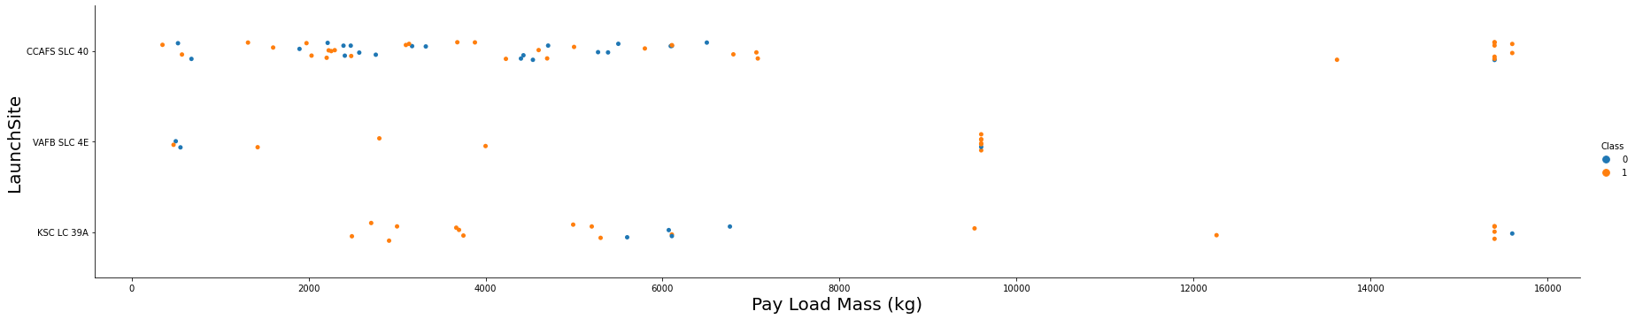
Payload vs. Launch Site
VAFB-SLC has no payloads with mass greater than 10,000 kg.
Majority of launch have a payload mass of under 8,000 kg.

Slide 19
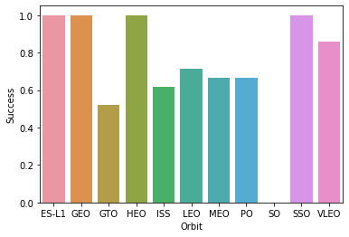
Success Rate vs. Orbit Type
ES-L1, GRO, HEO, SSO orbit types have the highest success rate. Succeeding 100% of the time.
While GTO has the lowest success rate.

Slide 20
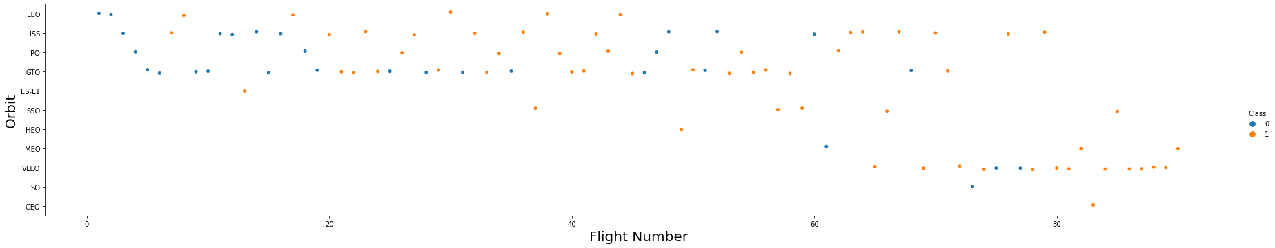
Flight Number vs. Orbit Type
Earlier flights focused on sending payload to LEO, ISS, PO, and GTO orbits.
Later flights started to send payload to VLEO – many of those are Starlink launches.

Slide 21
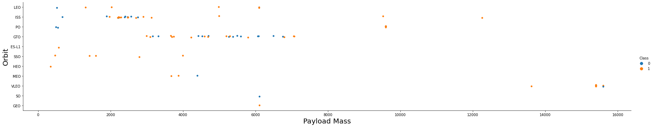
Payload vs. Orbit Type
Certain orbits have certain payload ranges
When launching to VLEO the Falcon 9 can carry close to 16,000 kg
When flying to the ISS, a typical launch would carry payload in 2,000 – 3,000 kg
While to GTO the payload range of 3,000 – 7,000 kg

Slide 22
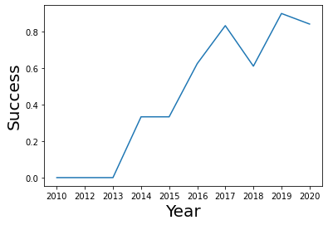
Launch Success Yearly Trend
SpaceX has made dramatic improvements to successfully landing their boosters.

Slide 23
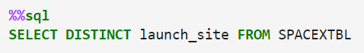
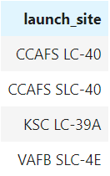
All Launch Site Names

Slide 24
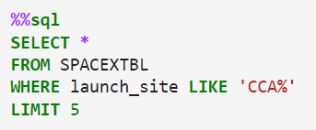
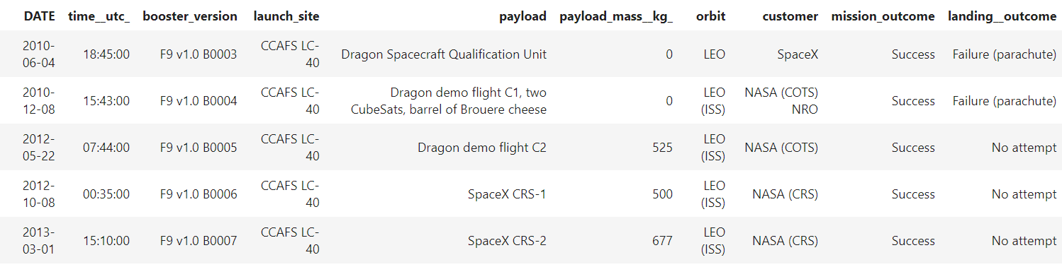
Launch Site Names Begin with 'CCA'

Slide 25
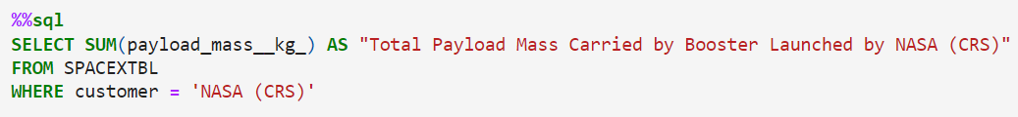
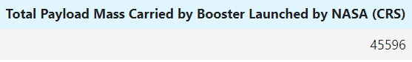
Total Payload Mass

Slide 26
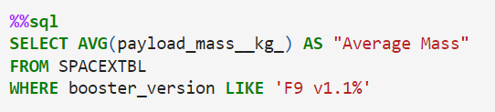
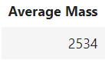
Average Payload Mass by F9 v1.1

Slide 27
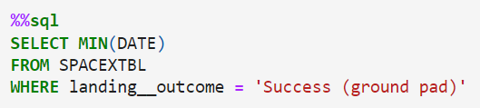
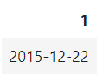
First Successful Ground Landing Date

Slide 28
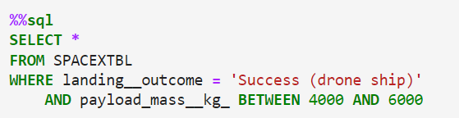
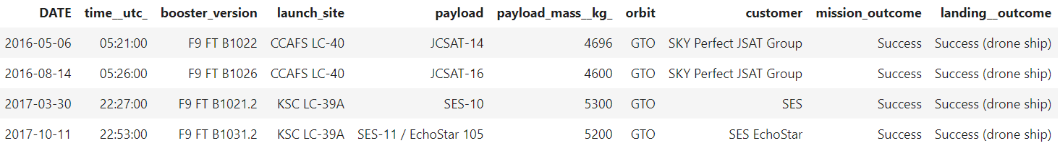
Successful Drone Ship Landing with Payload between 4000 and 6000

Slide 29
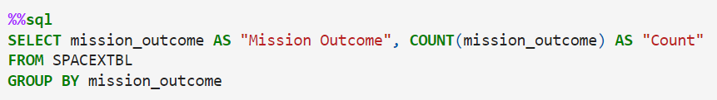
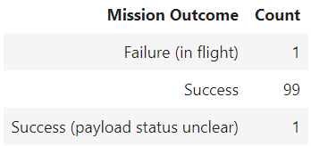
Total Number of Successful and Failure Mission Outcomes

Slide 30
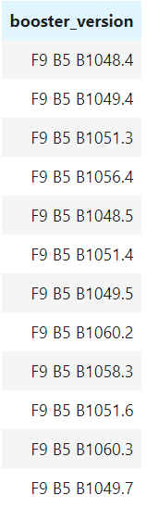
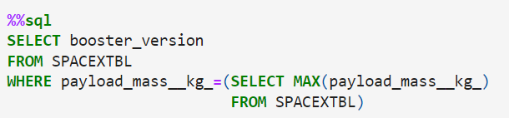
Boosters Carried Maximum Payload

Slide 31
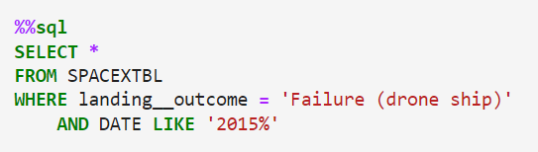
2015 Launch Records

Slide 32
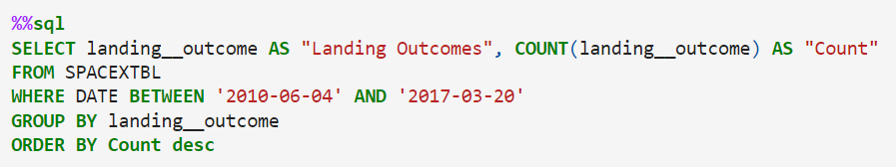
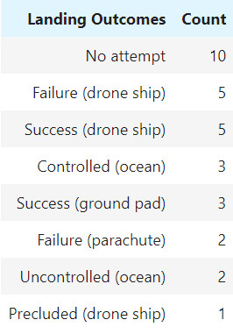
Rank Landing Outcomes Between 2010-06-04 and 2017-03-20

Slide 33

Section 3

Slide 34
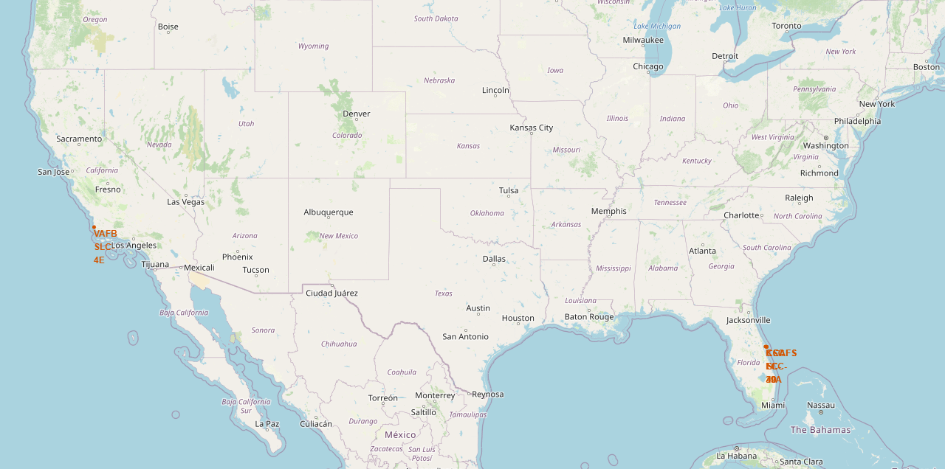
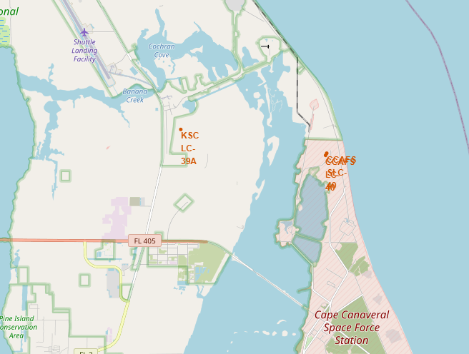
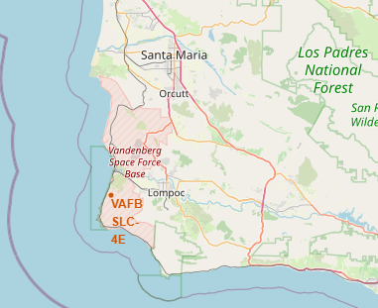
Locations of SpaceX Launch Sites
East Coast:
- Vandenberg Space Launch Complex 4
West Coast:
- Kennedy Space Center Launch Complex 39A
- Cape Canaveral Space Launch Complex 40
SpaceX has two launch sites in the US.
They are located next to the ocean so they can launch out to and land out in the sea
Sites on the east and west coasts
Sites as close to the equator in the US to take advantage of the earth’s spin.

Slide 35
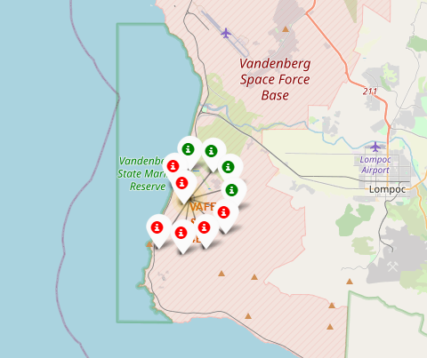
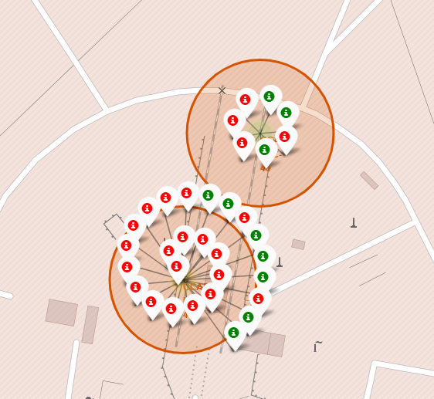
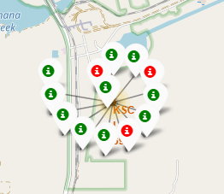
Launch outcomes from each site visualized
Vandenberg Space Launch Complex 4
- Cape Canaveral Space Launch Complex 40
Kennedy Space Center Launch Complex 39A

Slide 36
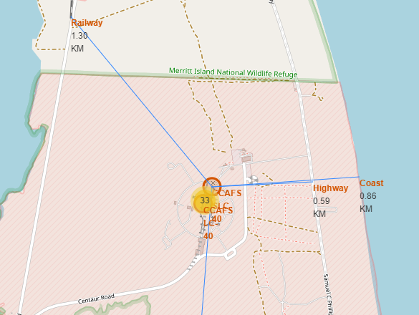
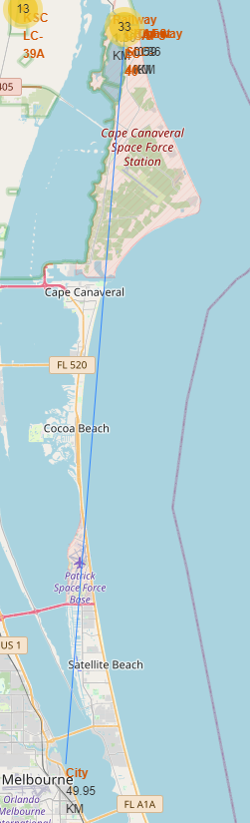
Proximity of the CCAFS SLC-40 launch site to key sites
Site | Distance / KM
Railway | 1.3
Highway | 0.59
Coast | 0.86
City | 49.95

Slide 37

Section 4

Slide 38
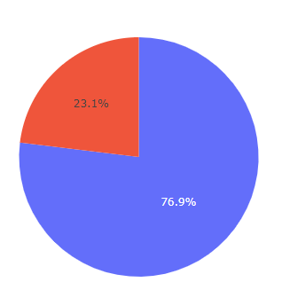
Total Success and Failures for SpaceX Launches
SpaceX are successfully launching their payloads over 75% of the time
Red: Failure
Blue: Success

Slide 39
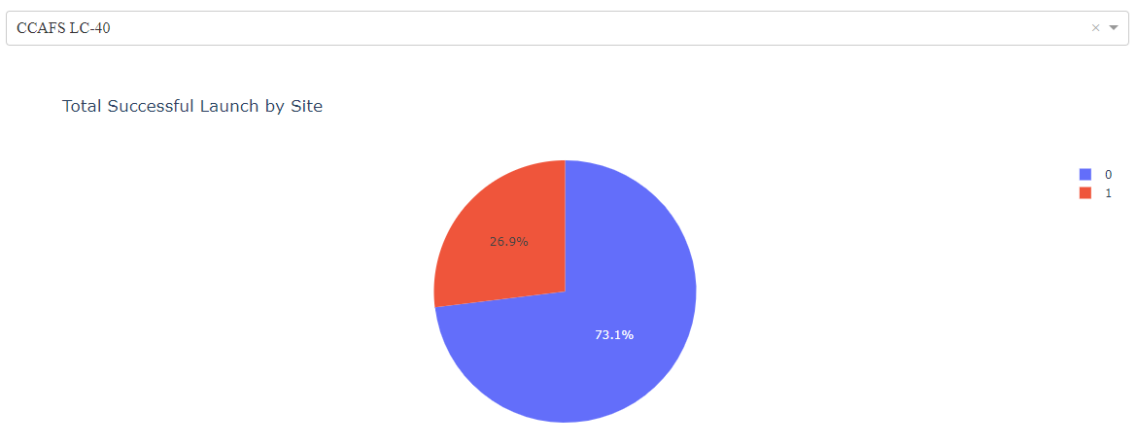
CCAFS LC-40 has launched the most successful number of missions
Red: Failure
Blue: Success

Slide 40
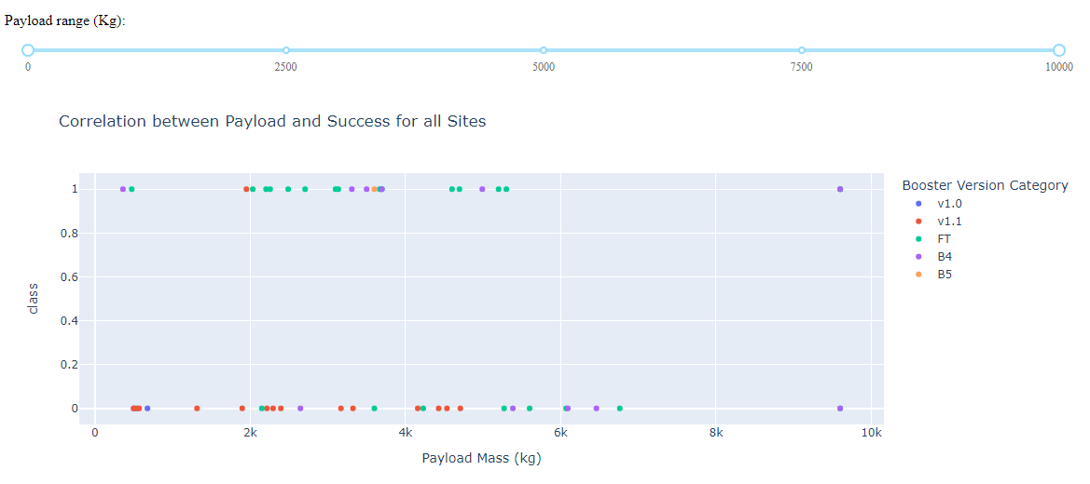
Payload vs. Launch Outcome
FT has a much higher success rate.
V1.1 had a very high failure rate

Slide 41

Section 5

Slide 42
Classification Accuracy

Slide 43
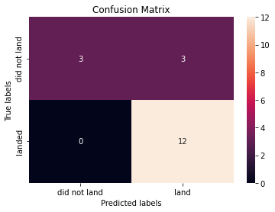
Confusion Matrix

Slide 44
Conclusions
Model preformed the same when used test data
Difference was observed with training data – there the decision tress preformed better.

Slide 45


